Slide 1
Property Price EDA Report
Name: Ajay Kumar

Slide 2
Introduction about the dataset
The objective of this analysis was to clean and prepare the Property_Price dataset for further analysis. The initial dataset consisted of 1459 rows and 81 columns.

Slide 3
Data Cleaning Process
Initial Data Shape:
The original dataset had a shape of (1459, 81)
Removing Unnecessary Columns:
The 'ID' column was removed as it did not provide any valuable information for the analysis. After further analysis, the following columns were identified as unnecessary and were removed: 'Lot_Extent', 'Lane_Type', 'Brick_Veneer_Type', 'Fireplace_Quality', 'Pool_Quality', 'Fence_Quality', and 'Miscellaneous_Feature'.

Slide 4
Data Cleaning Process
The dataset shape after removing these columns was (1459, 73).
Handling Missing Values:
Missing values in the dataset were handled using appropriate imputation methods: • Mean: Used for numerical columns. • Mode: Used for categorical columns. • Median: Used for columns where data distribution was skewed • The columns with imputed values include:- • ["Basement_Height", "Basement_Condition", "Exposure_Level", "BsmtFinType1", "BsmtFinType2", "Electrical_System", "Garage", "Garage_Finish_Year", "Garage_Quality", "Garage_Condition"]

Slide 5
Data Cleaning Process
After performing the above steps, the dataset was cleaned and ready for further analysis. Conclusion
The data cleaning process involved removing unnecessary columns, handling missing values, and ensuring the dataset was in a usable format. The final shape of the cleaned dataset is (1459, 73). This cleaned dataset provides a solid foundation for subsequent analysis and modeling efforts.

Slide 6
To gain a thorough understanding of our dataset, we utilized the Pandas Profiling tool for comprehensive data analysis. This tool facilitated both univariate and bivariate analyses, as well as correlation assessments.
link of Pandas Profiling Analysis:
https://drive.google.com/file/d/1zGGV5WYWxdVioV2zwHb9-hLP1aSp7ydd/view?usp=drive_link

Slide 7
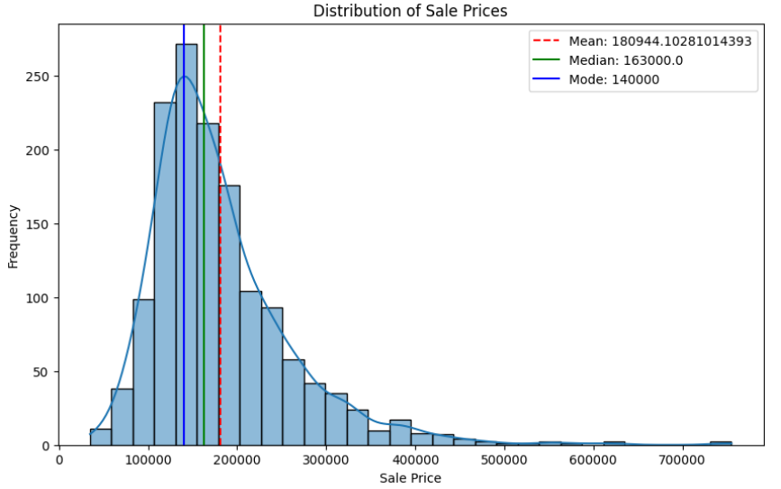
Exploratory Data Analysis(EDA) on the data.
Mean (Average) Price: 180944.10
Median Price: 163000.0
Mode Price: 140000

Slide 8
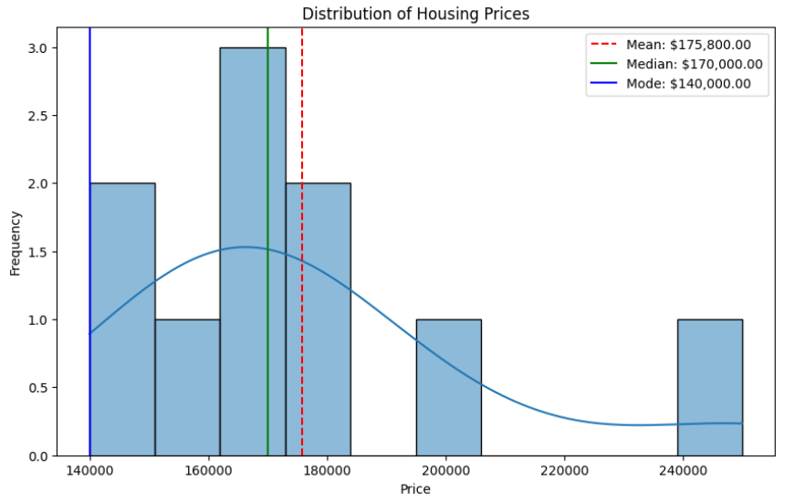
Exploratory Data Analysis(EDA) on the data.
This Picture provides a clear and comprehensive
explanation of the central tendency measures helping to understand the key aspects of the sales price data.

Slide 9
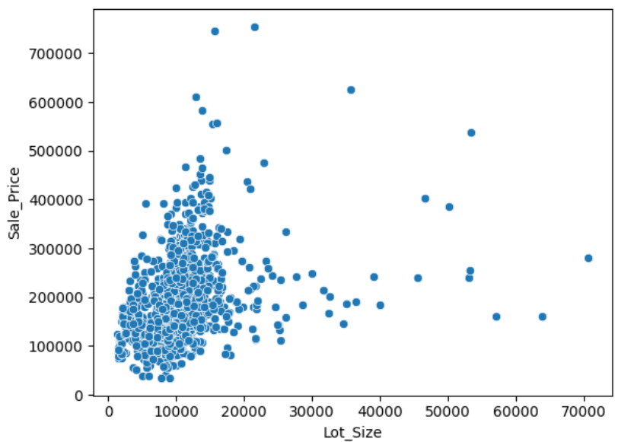
Exploratory Data Analysis(EDA) on the data.
Larger lots sell for higher prices.
But, sometimes, there are exceptions
where a big lot might not sell for
as much as expected or a
small lot might sell for more.

Slide 10
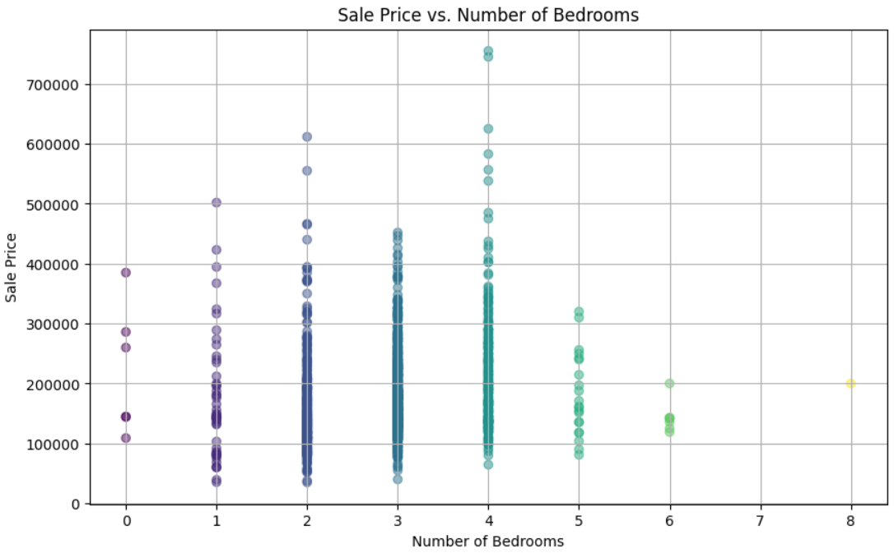
Exploratory Data Analysis(EDA) on the data.
Properties with more bedrooms
tend to sell for more money.
However, there are also some dots
that fall outside of this trend.

Slide 11
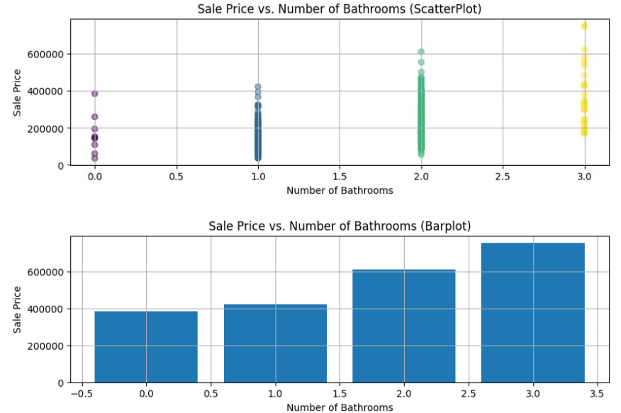
Exploratory Data Analysis(EDA) on the data.
Properties with more bathrooms
tend to sell for more money.
However, there are also some dots
that fall outside this trend.

Slide 12
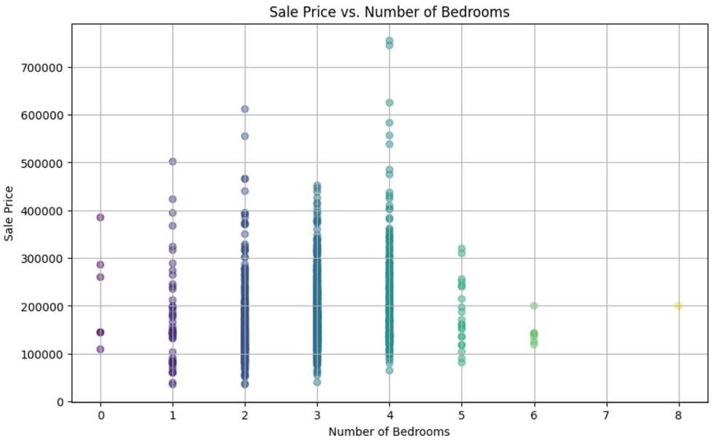
Exploratory Data Analysis(EDA) on the data.
Properties with more bedrooms tend to sell for more money. However, there are also some dots that fall outside of this trend.

Slide 13
Exploratory Data Analysis(EDA) on the data.
Properties with more bathrooms tend to sell for more money. However, there are also some dots that fall outside this trend.

Slide 14
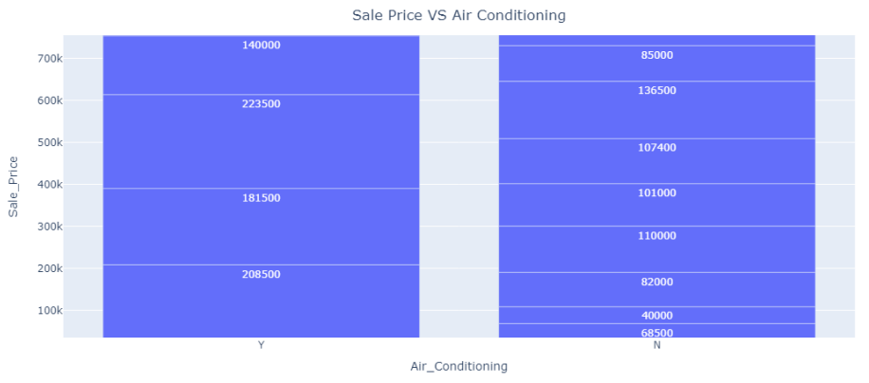
Exploratory Data Analysis(EDA) on the data.
As property prices increase, the price difference between perperties with air conditioning and those without also grows. In other words, more expensive properties tend to show a bigger price gap based on whether they have air conditioning installed.

Slide 15
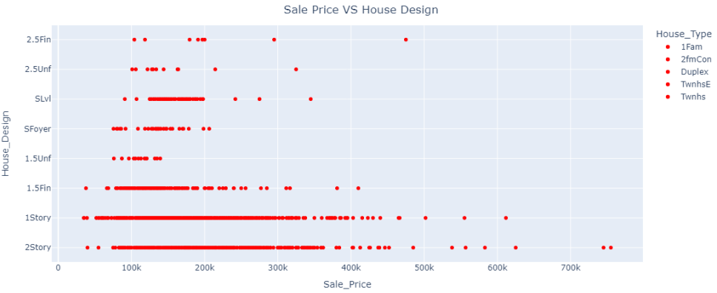
Exploratory Data Analysis(EDA) on the data.
2.5Fin and 2.5Unf categories have very few records (only 20 each), indicating these designs are less common.
1Story and 2Story houses are the most common designs with a wide range of sale prices.
2Story houses generally command higher prices, indicating a likely positive correlation between having multiple stories and higher sale prices.
The spread of prices in 1Story houses suggests a broad market segment with varying prices based on other factors (like size, location, etc.).

Slide 16
Feature Selection
The initial dataset had a shape of (1459, 73).
After performing feature selection, the data shape is now 1459 rows × 48 columns.
The removed columns included those identified by ANOVA and correlation tests, such as
'Overall_Material', 'House_Condition', and 'Garage_Size', among others, as well as categorical features like 'Road_Type', 'Utility_Type', and 'Heating_Type'.

Slide 17
Feature Transformation
After feature selection, I transformed the columns using appropriate encoding techniques:
OneHotEncoding for categorical features.
Binary mapping for binary features.
Ordinal encoding for ordinal features.

Slide 18
Data Modeling and Performance measure
After applying linear regression on the transformed data, the R² score improved to 69%, which is better than the previous score.
Then I employed a variety of algorithms to compare their performance. These included Decision Tree, Random Forest, Gradient Boosting, Support Vector Regression (SVR), k-Nearest Neighbors (k-NN), Ridge Regression, Lasso Regression, ElasticNet, and a Neural Network using the MLPRegressor with a maximum of 1000 iterations. Additionally, I used XGBoost to further enhance the model's performance. By evaluating these diverse models, I aimed to identify the most accurate and robust approach for my predictive task.

Slide 19
Data Modeling and Performance measure
Before Transformation (High Feature Dimensionality - 81 features):
Decision Tree (DT): High MSE (1.34 billion) and moderate R² (0.72) indicate a poor fit. The large number of features might be causing overfitting.
Random Forest (RF): Lower MSE (494 million) and high R² (0.89) suggest a better fit than DT. However, there's still room for improvement.
Gradient Boosting (GB): Even lower MSE (412 million) and a very high R² (0.91) show the best fit among tree-based models before transformation.
Support Vector Regression (SVR): Very high MSE (513 billion) and negative R² indicate a complete failure to capture the relationship. This model likely doesn't suit this data.
k-Nearest Neighbors (k-NN): Moderate MSE (820 million) and R² (0.83) suggest a decent fit, but there's potential for improvement.
Ridge, Lasso, ElasticNet: These regularization models show moderate MSEs (around 500 million) and R²s (around 0.89), indicating a trade-off between underfitting and overfitting due to regularization.
Neural Network (NN): Very high MSE (610 billion) and negative R² imply a complete failure to learn from the data. The high dimensionality might be overwhelming the network.
XGBoost: Similar performance to Gradient Boosting with slightly lower MSE and slightly higher R².

Slide 20
Data Modeling and Performance measure
After Transformation (Reduced Feature Dimensionality - 48 features):
All Models: A significant decrease in MSE (all below 1) and a general increase in R² suggest a much better fit for all models. The data transformation likely addressed the issue of high dimensionality.
DT, RF, GB, k-NN: These models show substantial improvements with much lower MSEs and higher R²s, indicating the benefit of dimensionality reduction for tree-based and nearest neighbor methods.
SVR: Still shows a high MSE, although lower than before. This suggests SVR might not be suitable for this data even after transformation.
Ridge, Lasso: Both models show a significant increase in MSE and a negative R². This indicates overfitting due to the regularization being too strong for the lower dimensional data. We might need to adjust the regularization parameters.
ElasticNet: Similar to Ridge and Lasso, it also suffers from overfitting with high MSE and negative R².
NN: Shows improvement with lower MSE and positive R², but still performs worse than other models. The reduced dimensionality might have helped, but the network architecture might still need adjustments.
XGBoost: Maintains a good balance with a low MSE and a high R², suggesting it benefits from the reduced dimensionality while avoiding overfitting.

Slide 21
Data Modeling and Performance measure
Best Performer
Based on the scores after data transformation, Gradient Boosting and XGBoost are the clear winners with the lowest MSEs and highest R²s. They seem to be most effective in capturing the underlying relationships after dimensionality reduction. Here's a breakdown:
Gradient Boosting & XGBoost (MSE: 0.1372 & 0.1565, R²: 0.8302 & 0.806): These models perform very similarly, making it difficult to definitively choose one. You might need to perform further hyperparameter tuning or compare them on a hold-out validation set to determine the absolute best.
Random Forest (MSE: 0.1429, R²: 0.8231): A close contender, performing slightly worse than the top two.
k-NN & SVR (MSE: 0.1887 & 0.1263, R²: 0.7665 & 0.8437): These models show decent performance, but fall behind the top performers. SVR's high R² might be misleading due to its overall high MSE.
Other Models (Ridge, Lasso, ElasticNet, Neural Network): These models suffered from overfitting after dimensionality reduction and require further adjustments.

Slide 22
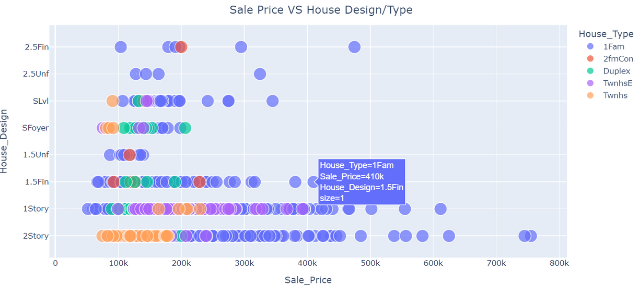
Exploratory Data Analysis on the clean Data
It shows that single-family homes (1Fam) dominate the market and that 2.5Fin houses tend to have higher prices, while 2Story and 1Story houses are more common in the lower to mid-price ranges.

Slide 23
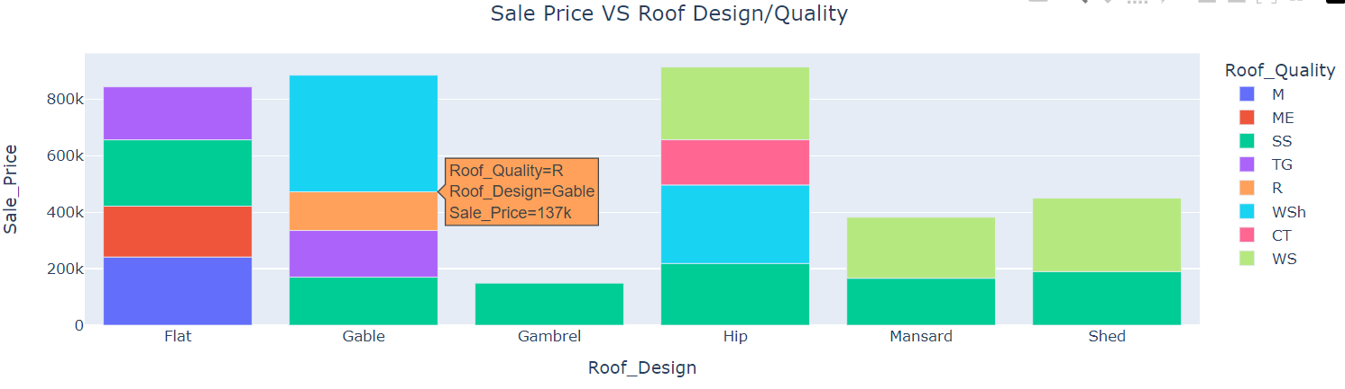
Exploratory Data Analysis on the clean Data
From graph gabled roof tends to be the most expensive design, with an average sale price of around $137k. Homes with a flat roof or a hip roof tend to be the least expensive on average.

Slide 24
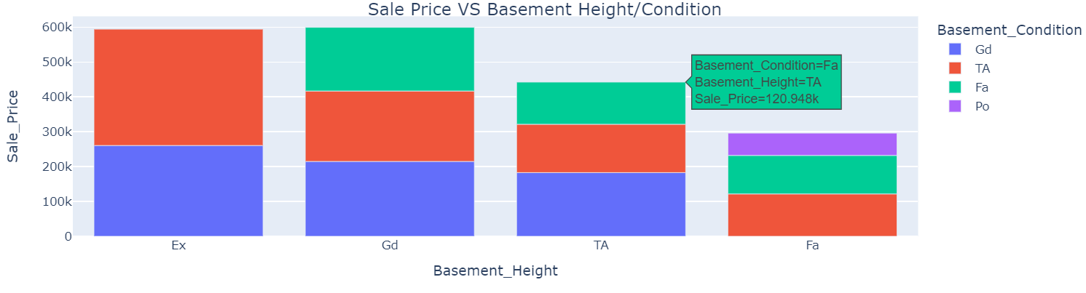
Exploratory Data Analysis on the clean Data
There are houses with high basements (presumably rated Excellent or Good) that sold for a lower price than houses with shorter basements (possibly rated Fair or Poor).
Similarly, there are houses with Poor or Fair condition basements that sold for a higher price than those with Excellent or Good condition basements.

Slide 25
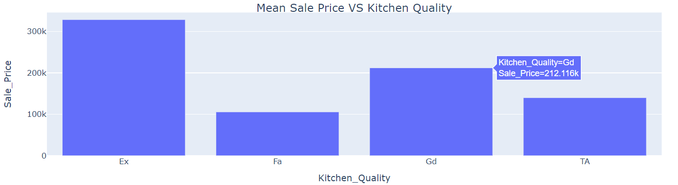
Exploratory Data Analysis on the clean Data
Graph shows a trend where the average sale price is relatively low for kitchens rated Good while Excellent kitchens have a higher average sale price.

Slide 26
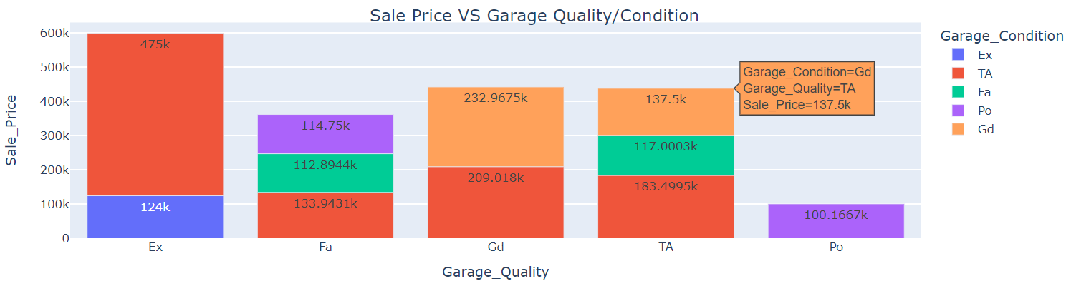
Exploratory Data Analysis on the clean Data
There is a positive correlation between sale price and garage condition. This means that houses with garages in better condition tend to sell for more than houses with garages in poorer condition.
For example, a house with a garage in Excellent condition (Ex) might sell for an average price around 600k, whereas a house with a garage in Poor condition (Po) might sell for an average price around 100k.

Slide 27
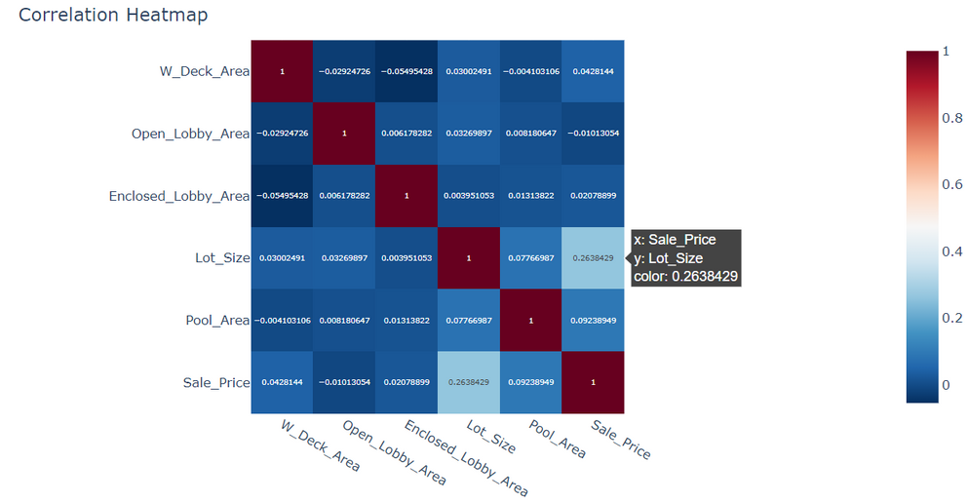
Exploratory Data Analysis on the clean Data
We can see that there is a strong positive correlation between sale price and lot size. This means that houses with larger lots tend to sell for more money.
There is also a weak positive correlation between sale price and open lobby area. This means that houses with larger open lobby areas tend to sell for more money
But the correlation is not as strong as the correlation between sale price and lot size. There is a weak positive correlation between sale price and enclosed lobby area
There is a negative correlation between sale price and enclosed lobby area. This means that houses with larger enclosed lobby areas tend to sell for less money. However, it's important to note that the correlation is not very strong.

Slide 28
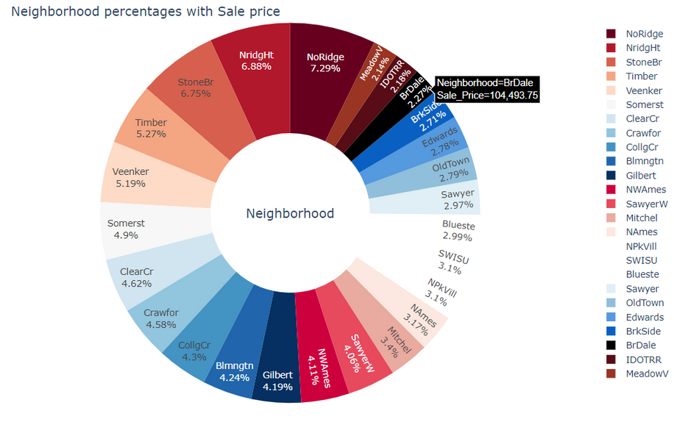
Exploratory Data Analysis on the clean Data
The pie chart represents the percentage distribution of neighborhoods within Ames city limits, along with their respective sale prices. Here’s an analysis of the trends depicted in the chart:
NoRidge (7.29%) and NridgHt (6.88%) have the highest percentages, indicating that these neighborhoods are the most common or have the highest sales volumes within the dataset.
StoneBr (6.75%) and Timber (5.27%) also constitute a significant portion of the sales, suggesting that these neighborhoods are also popular or have a high frequency of sales.
Veenker (5.19%), Somerst (4.9%), ClearCr (4.62%), and Crawfor (4.58%) show notable percentages, reflecting their importance in the housing market.
Other neighborhoods such as CollgCr, Blmngtn, Gilbert, NWAmes, SawyerW, Mitchel, NPkVill, SWISU, Blueste, and others have varying percentages, with the lower end around 2.7% (BrDale, BrkSide).

Slide 29
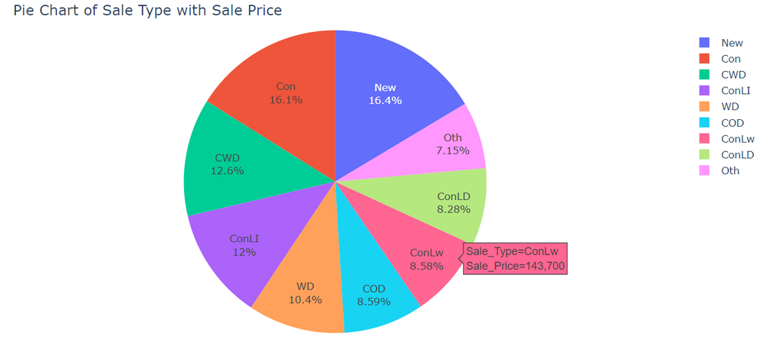
Exploratory Data Analysis on the clean Data
The pie chart illustrates the distribution of different sale types with their corresponding percentages.
New (16.4%) and Con (16.1%) have the highest percentage, indicating that newly constructed homes and properties sold through a contract with a 15% down payment on regular terms are the most common sale types.
CWD (12.6%) and ConLI (12%) also constitute a significant portion of the sales. Cash sales (CWD) and sales through a contract with low interest (ConLI) are popular among buyers.
WD (10.4%) and COD (8.59%) follow next, showing that conventional warranty deed sales and court officer deed/estate sales are also relatively common.
ConLw (8.58%) and ConLD (8.28%) have similar proportions, suggesting that sales through contracts with low down payment and low interest or low down payment are also utilized options.
Oth (7.15%) is the least common, indicating other types of sales are less frequent.

Slide 30
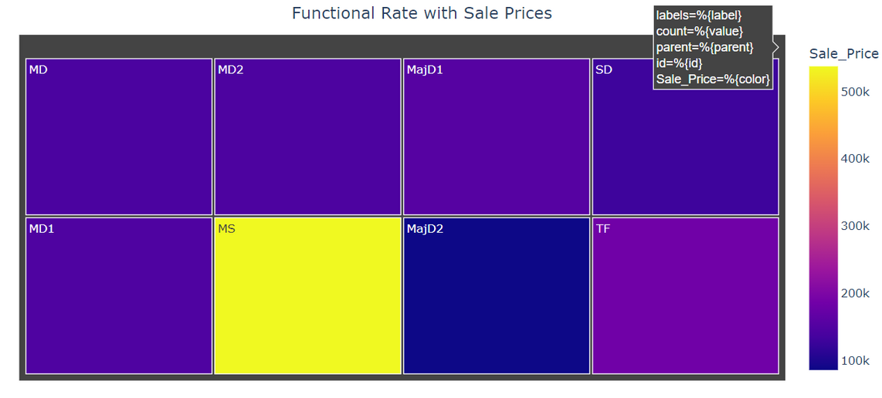
Exploratory Data Analysis on the clean Data
The tree map visualizes the distribution of different functional rates of homes along with their sale prices.
The chart indicates that the condition of the home (functional rate) has a noticeable impact on the sale price. Homes with typical functionality command the highest prices, while those with severe damage or major deductions have the lowest sale prices.

